Slide 1
Friendstagram
Live Recorded Video: https://youtu.be/mhuxYT8mv8w
Make your university experience more fruitful
Team Inspiration
Notes:
Ideation & Use Case Diagram
Primary Use Cases

Slide 2
Our Team
Manav Arora
Tan Hui Zhan
Jovan Huang
Royce Ang
Zhu Weiji
Clarence Hong
U1822077D Project Manager
U1921768B
QA Manager
U1922013D
QA Engineer/ UI+UX
U1840416D
Lead Developer
U1922950G
Release Engineer/Manager
U1922876G
Backend Developer

Slide 3
01
02
03
04
Product Introduction
Design for Maintainability
Software Quality Assurance
Project Management
Outline of Presentation
05
Risk Management
Key features of the product
Measures taken to ensure product is maintainable
Processes to ensure quality of product
Breakdown of Project
Reasoning, Approach and Risk Processes & Plans

Slide 4
01 Product Introduction
Notes:
Product Introduction and how we came out with the idea.

Slide 5
What are the current issues brought about by Covid-19 that you would like to solve as an NTU student today?
Notes:
Our journey of creating Frienstagram started from the first lab,
we started off by asking ourselves
“What are the current issues brought about by Covid-19 that you would like to solve as an NTU student today?”

Slide 6
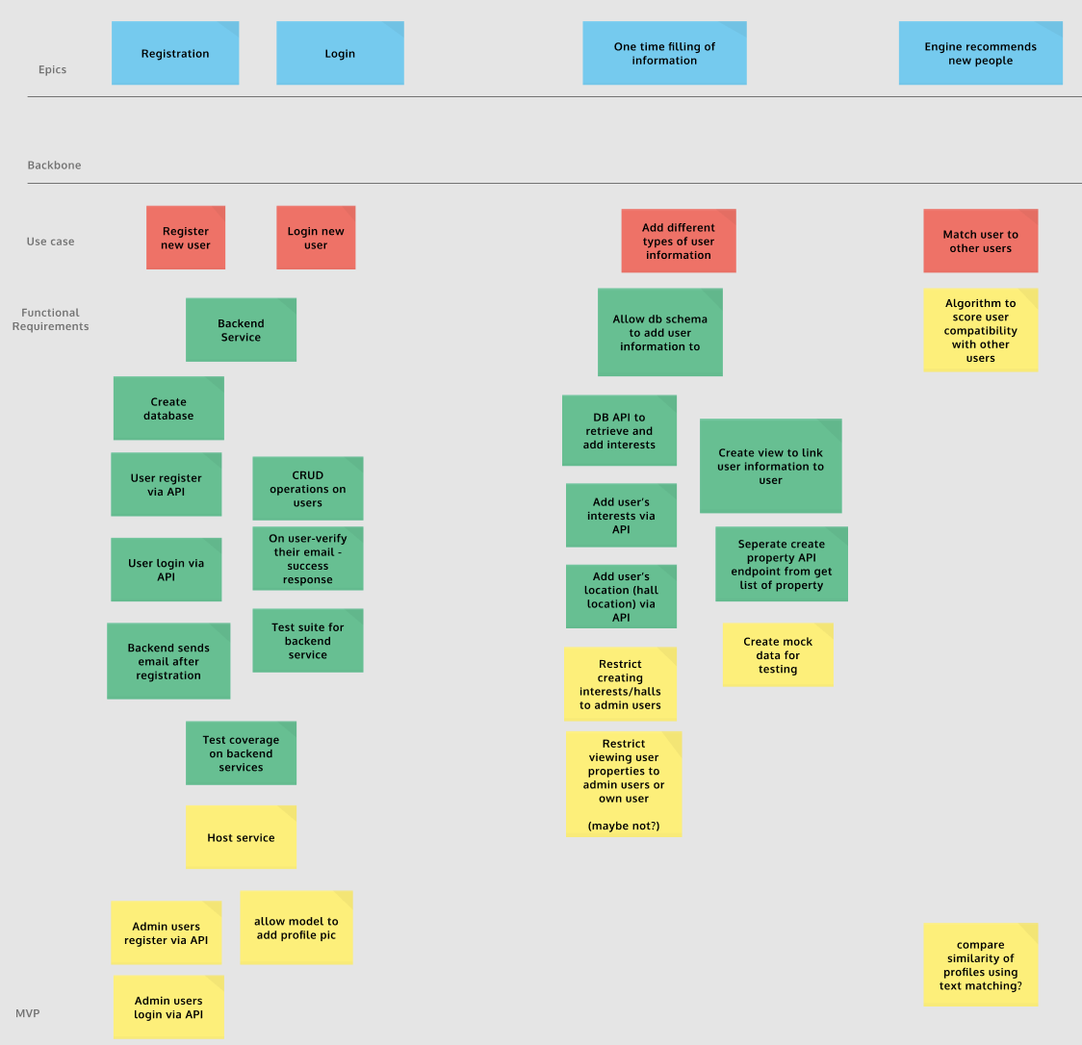
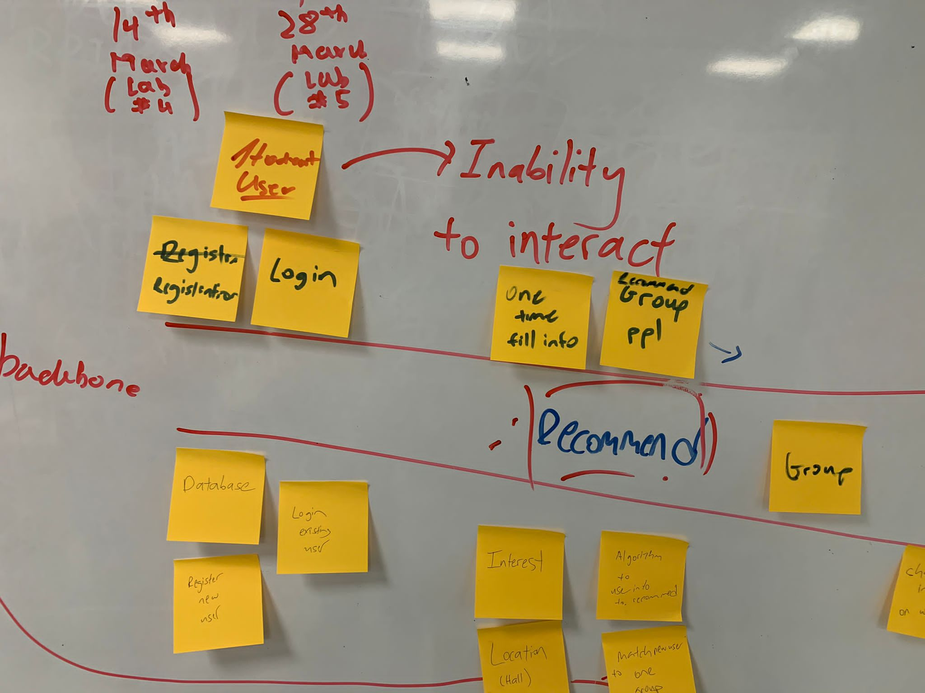
User Story Mapping - Jeff Patton
The hand that wrote a
page, built a city
Notes:
Using the concept of user story mapping, we were able quickly iterate on our ideas using conventional whiteboard and stickies(on the left), which were then translated to Figma(on the right.)
And ultimately, narrowing down to 4 main pain points that NTU students face today

Slide 7
Pain Points To Resolve
Lack of interaction
No sense of belonging
Fear of Socialising
Unhappiness
Lessons become online & CCAs are cancelled
Students find it challenging to feel connected to a community
Students aren't sure how to start rebuilding their social lives.
Significant drop in satisfaction with courses in university
Notes:
During covid-19, we realize that NTU students face the lack of interaction due to the lessons being made online;
We also realize that the students find it very difficult to feel connected to a community; which led to the a significant drop in happiness.
And most had developed a fear of socializing.
During covid-19, students were not given sufficient opportunities to interact due to lessons being made online; We also found out that students found it challenging to feel attached to their own communities.
… & worse of all, developing a fear of socialising.
And therefore, to combat these 4 painpoints, we have created a web-application that aims to

Slide 8
Aim
A personalized web-app that helps
Like-minded Students
Connect,
Find New Friends,
Rediscover Sense of Belonging
The hand that wrote a
page, built a city
Notes:
Friends recommended to the user through a carefully curated and highly personalised state-of-the-art algorithm
We have 4 main features to achieve this aim

Slide 9

FIND
FRIENDS
Feature #01
Friends recommended to the user through a carefully curated and highly personalised state-of-the-art matching algorithm
Notes:
Our very first feature is `Find Friends’, which allow users to find new friends with similar interest and hall accommodation using our matching algorithm.
Using our curated matching algorithm, users are able to find new friends based on similar interests and hall accomadaito.
(Using the state-of-the-art matching algorithm, users will be matched with new friends based on how similar their interests are and the kind of hall accommodation they are in.) - John

Slide 10
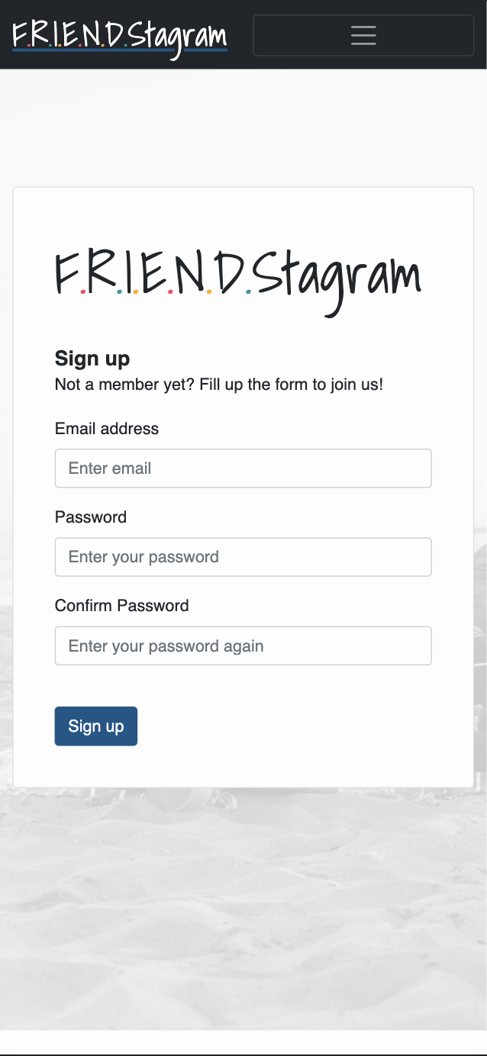
ACCOUNT CREATION
Feature #02
Allowing users to create their own accounts with interests and halls for a more personalised experience.
Notes:
Our second feature is account creation, where users are able to benefit from a personalized experience; and more specifically allowing users to have security and control over their information.
We’re able to give users a personalized experience, where they have control over their information and security.

Slide 11
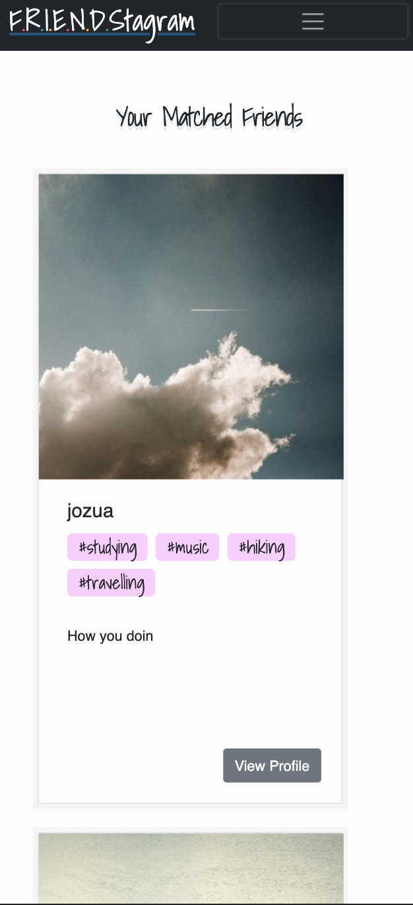
BROWSE
MATCHES
Feature #03
A catalogue of recommended friends that users can browse through.
Notes:
Our third feature is browse matches, which allow users to browse through a catalogue of potential new friends.
Browse matches -> Users will provided with a catalog of potential new friends

Slide 12
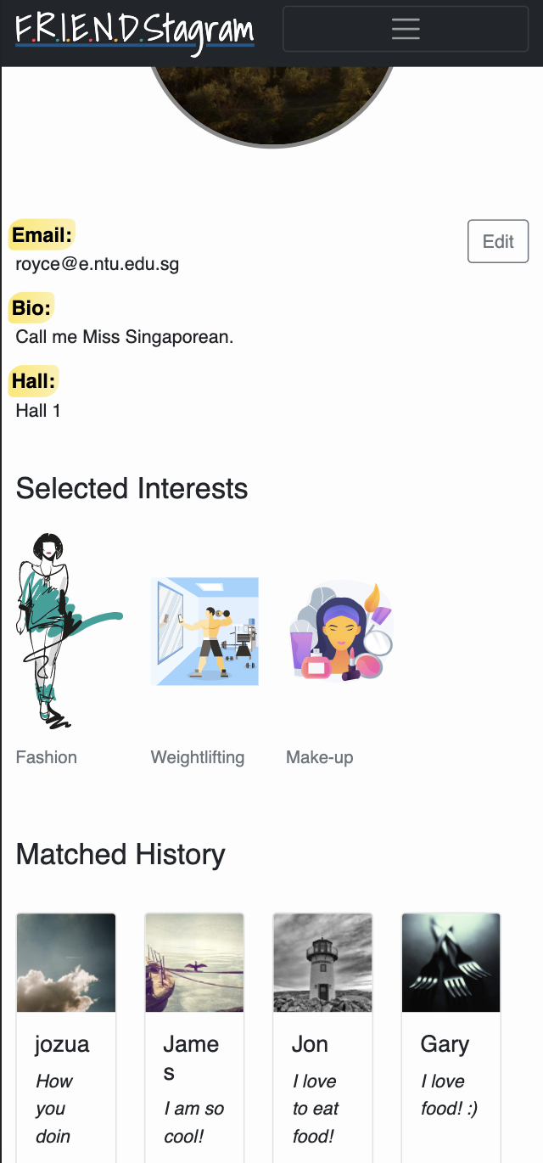
MATCHED HISTORY
Feature #04
Users are able to access their matched-friends and selected interests history via their profile page.
Notes:
And our final feature: allows user to browse through the list of friends whom they have matched before.
Brose through list of friends whom they were successfully matched with.

Slide 13
02 Design for Maintainability
Notes:
ifandonlyif - Design Report on Software Maintainability.docx - Google Docs

Slide 14
Approach
Architectural Design Patterns
Release Management
Configuration Management
Early Planning
Ensure stability and correctness of release builds
Predict potential pitfalls
Establishing consistency of a product's attributes
Manage complexity with architecture

Slide 15
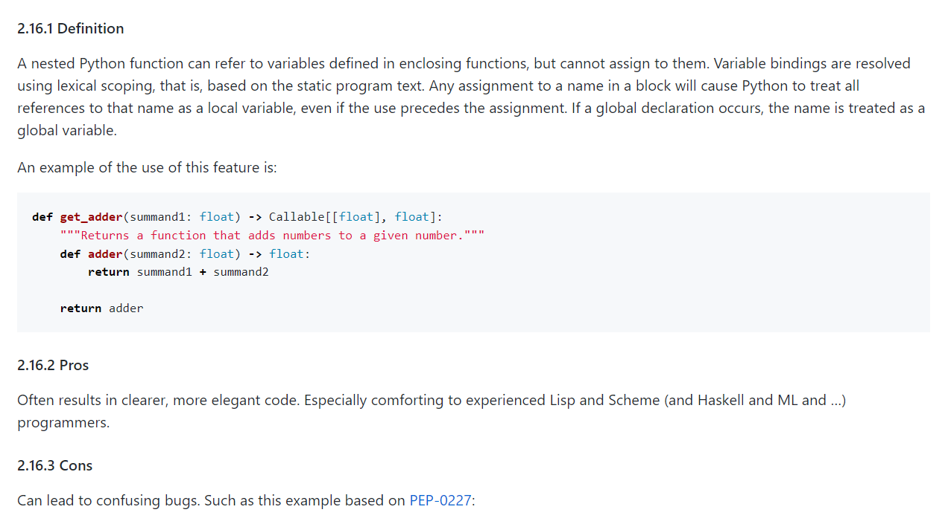
Early Planning
Predict potential pitfalls
Manage complexity with architecture
Establishing consistency of a product's attributes
Ensure stability and correctness of release builds
1. Identify complex features for analysis
2. Allow room for extension
3. Standardise code
with style guides
Google styleguide | Python
Notes:
Style guide -- code this not that
Eg. Lexical Scoping in python -

Slide 16
Complex Feature: Matching Algo

Slide 17
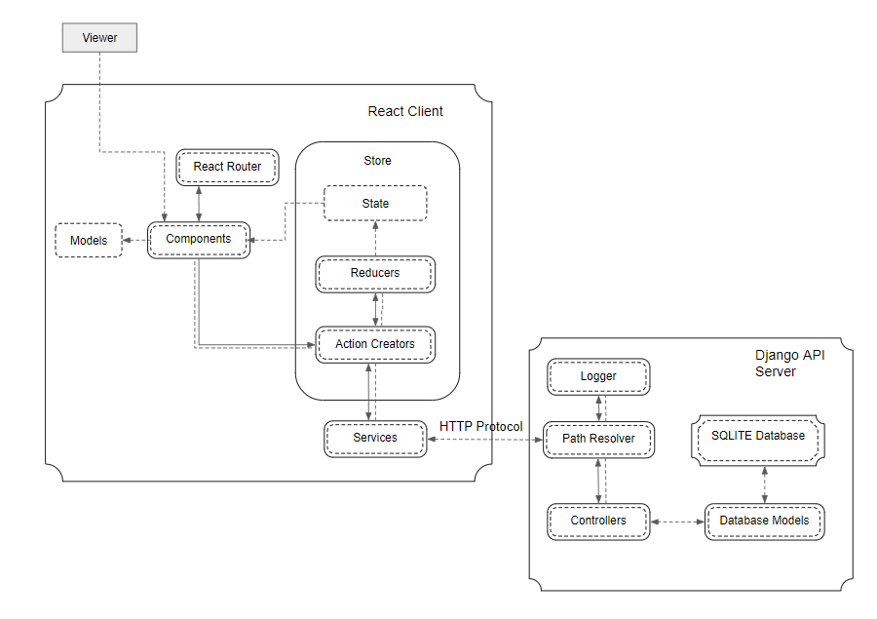
Architectural Design Patterns
Predict potential pitfalls
Establishing consistency of a product's attributes
Ensure stability and correctness of release builds
Manage complexity with architecture
Overall Architecture
Client-Server model
Frontend
Backend
Component-based
software engineering
(CBSE)
Create independent components with React
Model-View-Controller (MVC)
Use Django to implement a RESTful API
Notes:
Note: `Reusable` component

Slide 18


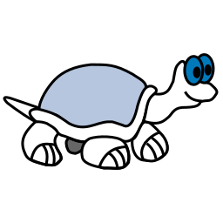

Configuration Management
GitHub
Google Drive
MediaWiki
TortoiseSVN
Predict potential pitfalls
Manage complexity with architecture
Ensure stability and correctness of release builds
Establishing consistency of a product's attributes
Version Control and Source Management
Documentation Collaboration
Online form of Documentation
Version Control & Documentation Management

Slide 19
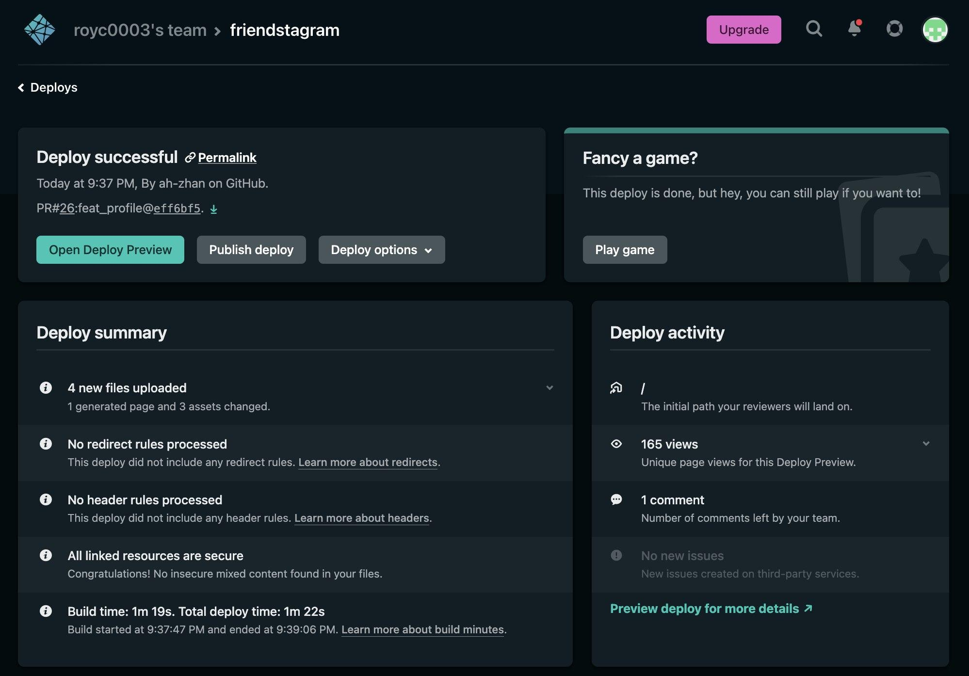
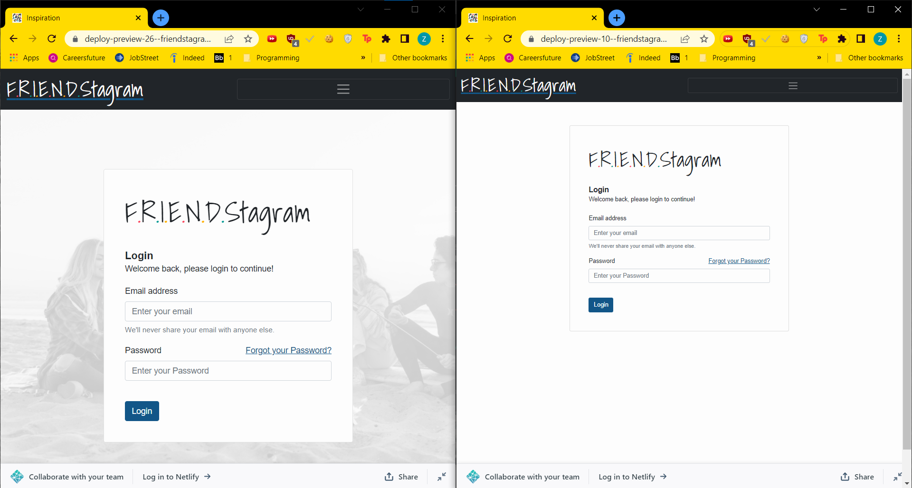
Release Management
Predict potential pitfalls
Manage complexity with architecture
Establishing consistency of a product's attributes
Ensure stability and correctness of release builds
Enable stable releases via Netlify’s Deploy Previews
Run automated tests on deploy builds
Notes:
Magnabegable verison control; stable and release and roll-back

Slide 20
03 Software Quality Assurance
Notes:
Now, I will talk about how we assured our software quality.

Slide 21
Key Process Areas
Process Goal
Commitment to Perform
Ability to Perform
Activities Performed
Measurements & Analysis
Verify Implementation
Provides the framework necessary to ensure a consistent approach to software quality assurance throughout the project life cycle
Monitor testing efforts to assure that test schedules are adhered to and maintained to reflect an accurate progression of the testing activities.
Provision of training, resources, and tools
Planning, Implementation, Review, Correction
Metrics used in SQA include fan-in/fan-out, length of code, length of identifiers, fog index, application crash rate, cyclomatic complexity
Ensure test management processes and products are being implemented per Test Plan.
Notes:
During the process of quality assurance, there are 6 main areas.
Firstly, the process goal. We have to provide the framework necessary to ensure a consistent approach to software quality assurance through the project.
Next, we have to be committed to perform quality assurance, by consistently monitoring testing efforts to assure that we follow test schedules.
In order to ensure we are able to perform quality assurance, we have to be provided relevant training, resources and tools.
The activities we have to carry out are: Planning, Implementation, Review and Correction.
To measure and analyse our software quality, we have to use metrics like fan in/fan out, length of code, and so on.
Lastly, to verify our implementation of tests processes and products, we have to check against the test plan.
Fan-in/Fan-out - The number of other functions that call a specific function and the number of other functions called by a specific function should be low so that the code is less coupled and flexible, allowing for changes to be made to the code without extensive effects.
Length of code - The length of code measures the extent of the program and the complexity. A longer code length usually corresponds to a more complex program. This could result in more opportunities for bugs if regular code reviews are not conducted.
Length of identifiers - This allows us to understand how easy it is to understand our project code. As this project is handled by multiple developers and parties, having purposefully named and intuitive identifiers makes the process of understanding the code easier.
Fog index - Sentences and words in documents regarding the web application should be as short as possible, resulting in a low fog index, so as to not hinder the understanding of users. The more concise the documents, the easier to comprehend and understand how the web application works.
Application crash rate (ACR) - We calculate the ACR by dividing the frequency of application crashes by the frequency of its usage. This allows us to track the reliability of our application.
Cyclomatic complexity - This is measured by counting the number of branches in a control-flow graph. This helps us to maintain the complexity of the source code at an easy-to-understand level.

Slide 22
Assessments
Product Assessment
Process Assessment
Evaluating each Component:
User Creation, Matching, Editing Profile
Evaluating each Process: Risk Management, Configuration Management, Change Management, Release and Test
Notes:
Moving on to assessments, we will conduct product assessments on the:
Recommendation
Profile
Review bubble tea
Search bubble tea
View bubble tea
Recommendation history and
Posting review components
Also, We have to evaluate the following process assessments such as:
Risk Management
Configuration Management
Change Management
Release and
Test Processes

Slide 23
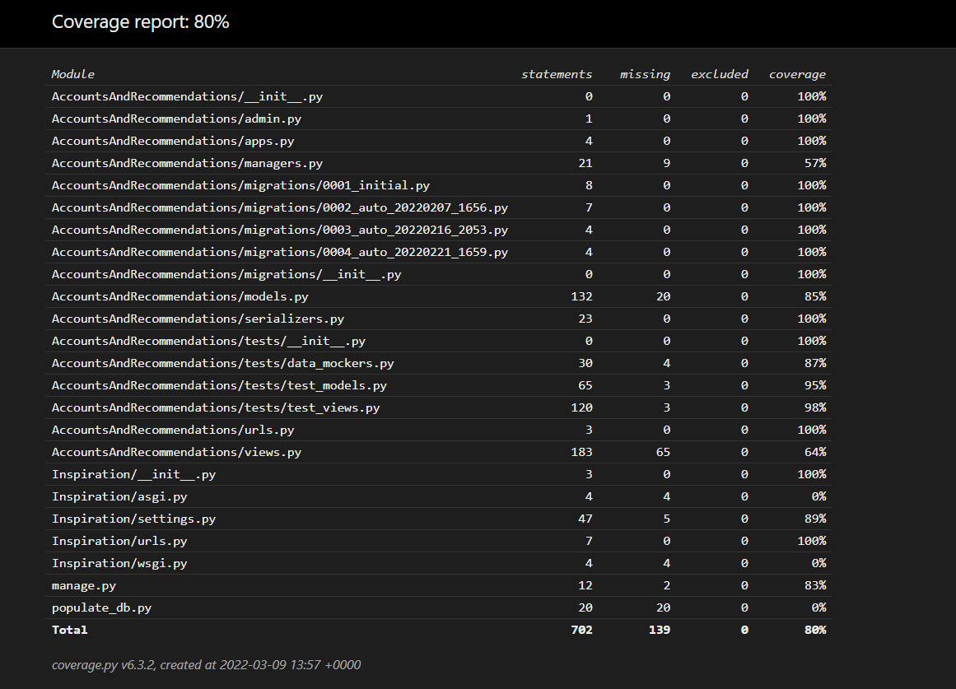
White Box Testing
Notes:
The four most important software qualities for Mr. Boba are Functionality, Portability, Efficiency and Usability.
To ensure functionality, unit and component tests will be written and run.
To ensure portability, the web app will be tested on different browsers and devices.
To ensure efficiency, the loading time of the web app will be measured.
Lastly, to ensure usability, we will measure its user friendliness via user feedback.
Test-driven Development, end-to-end testing
Why we need Functionality is that the web application needs to perform its functions well for users to be able to make use of its utilities.
Portability is important as the web application needs to run on different browsers like Firefox, Google Chrome, and so on. The web application also needs to run smoothly on both mobile devices and desktops.
For Efficiency, the loading time of the web application will be measured and should be at most 10ms,
Lastly, for Usability the web application needs to be intuitive and easy to use, making the recommendation process user-friendly. This will be evaluated via user feedback.
Now, I will hand over the time to Nicholas.

Slide 24
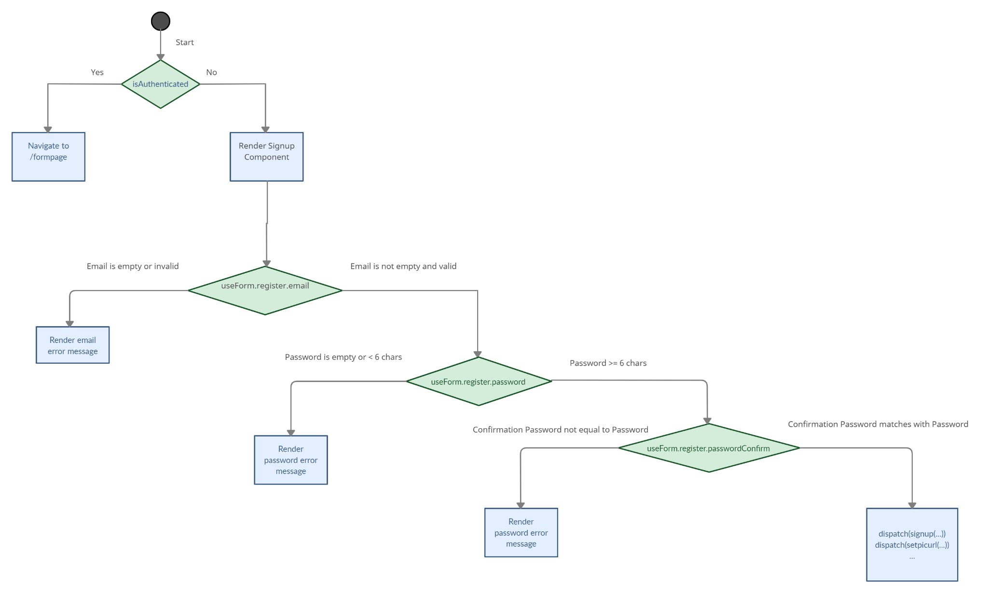
White-box Testing
Registration of new user
Cyclomatic Complexity: V(G) = E - N + 2 = P + 1 V(G) = 4 + 1 = 5
Notes:
The four most important software qualities for Mr. Boba are Functionality, Portability, Efficiency and Usability.
To ensure functionality, unit and component tests will be written and run.
To ensure portability, the web app will be tested on different browsers and devices.
To ensure efficiency, the loading time of the web app will be measured.
Lastly, to ensure usability, we will measure its user friendliness via user feedback.
Why we need Functionality is that the web application needs to perform its functions well for users to be able to make use of its utilities.
Portability is important as the web application needs to run on different browsers like Firefox, Google Chrome, and so on. The web application also needs to run smoothly on both mobile devices and desktops.
For Efficiency, the loading time of the web application will be measured and should be at most 10ms,
Lastly, for Usability the web application needs to be intuitive and easy to use, making the recommendation process user-friendly. This will be evaluated via user feedback.
Now, I will hand over the time to Nicholas.

Slide 25
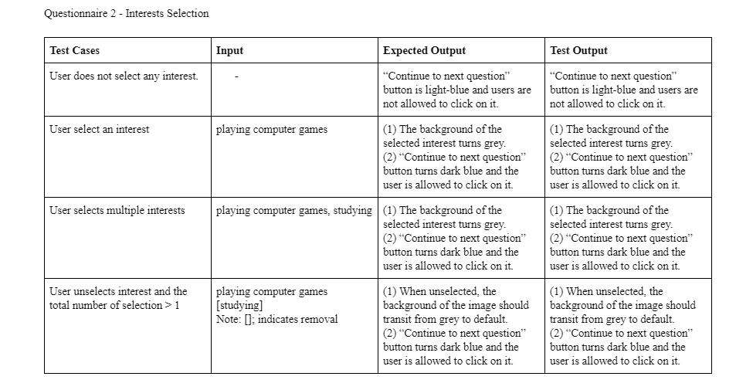
Black-box Testing

Slide 26
Software Quality
Availability
Portability
Efficiency
Usability
Testing on different platforms and browsers
Evaluate user friendliness via feedback
Downtime requirement
Define maximum acceptable loading time
Notes:
The four most important software qualities for Mr. Boba are Functionality, Portability, Efficiency and Usability.
To ensure functionality, unit and component tests will be written and run.
To ensure portability, the web app will be tested on different browsers and devices.
To ensure efficiency, the loading time of the web app will be measured.
Lastly, to ensure usability, we will measure its user friendliness via user feedback.
(Efficiency - Talk less on this)
Why we need Functionality is that the web application needs to perform its functions well for users to be able to make use of its utilities.
Portability is important as the web application needs to run on different browsers like Firefox, Google Chrome, and so on. The web application also needs to run smoothly on both mobile devices and desktops.
For Efficiency, the loading time of the web application will be measured and should be at most 10ms,
Lastly, for Usability the web application needs to be intuitive and easy to use, making the recommendation process user-friendly. This will be evaluated via user feedback.
Now, I will hand over the time to Nicholas.

Slide 27
04 Project Management
Notes:
ifandonlyif - Project Plan.docx - Google Docs

Slide 28
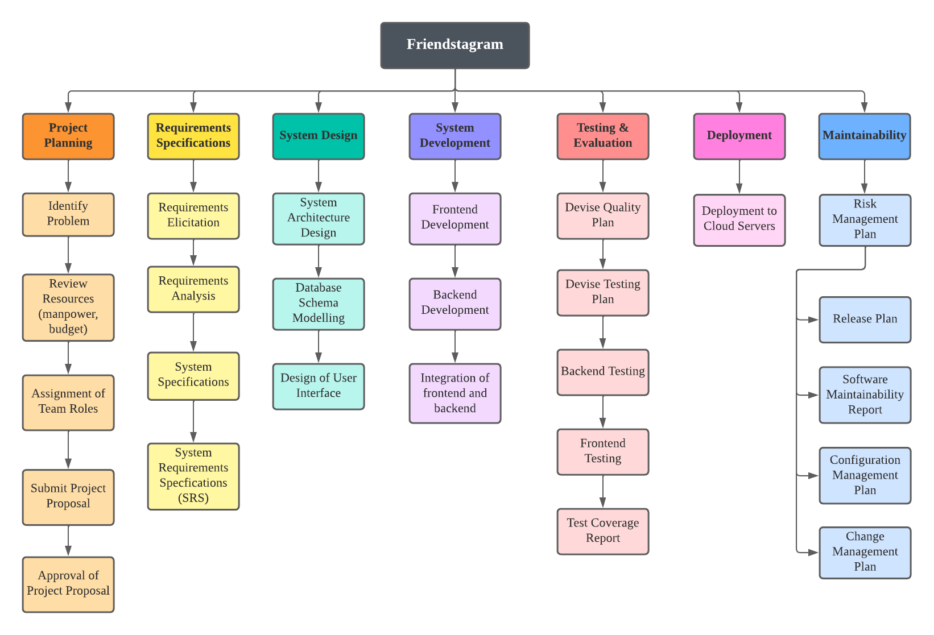
Work Breakdown Structure

Slide 29
Waterfall Model
Explanation & Benefits
Requirements
Development cycle is broken down into different phases wherein each phase is connected to the next sequentially
Each phase is well-defined and well-documented
Allows for speedy development while meeting strict deadlines
Clear and concise objectives across the development process.
Design
Development
Testing
Deployment
Maintenance

Slide 30
Activity Diagram & Work Package
Docs
Front End
Planning
Requirements
System Design
System Integration
System Testing
Handover
Back End

Slide 31
Best Practice Checklist
No. | Practices | ✔
1 | Documentation must be in a standardized format.
2 | Weekly meetings should be held in accordance with the Waterfall SDLC Model. Each member should be made aware of any changes.
3 | Changes in code must be checked by a fellow developer and must pass the specific test case, before it can be merged.
4 | Bugs and errors should be highlighted to all team members.
5 | Coding Style must be consistent and follow the preset guidelines.
6 | Project Scheduling should be done thoroughly and followed so that the project can be completed in a timely manner while meeting requirements.
7 | Software testing should be high priority and very thorough to ensure product quality and standards.
Notes:
Perhaps, have a more summarized version.

Slide 32
Monitoring and Control
Measurement of Resource Consumption
Regular Reviews of Project Progress
Identification of Major Project Risks
Timeline Planning and Task Decomposition

Slide 33
05 Risk Management

Slide 34
Risks
Impact
 | Low | Medium | High
High | Lack of physical team meetings
Med | Internal conflict |  | Requirements miscommunication Deadline Delays
Low |  |  | Team member unavailability
Probability

Slide 35
Strategies to mitigate risks
Team Member Unavailability
Requirements Miscommunication
Internal Conflict
Deadline Delays
Lack of Physical Team Meetings
Pair separation to cover
Scope for reassignment to maintain timeline
Thorough requirement solicitation and documentation
Follow documentation closely
Notify entire team about any change
Ensure clear and concise communication
Project manager should de-escalate any conflict
Seek external help if necessary
Good personal time management
Schedule must take into account any constraints
Schedule weekly online meetings
Regular updates on team text channels

Slide 36
Checkout our App
https://friendstagram.netlify.app/

Slide 37

Thank you.

